Slide 1

Project Title
SOA Project Review-1
Date& Time
 | Under the Guidance of Mary Navyatha Govindu Assistant Professor, Department of Computer Science and Engineering, KLH CSE Bowrampet Campus
Team Members M.Vaishnavi-2420090146 V. Durga Bhavani-2420030184 P. Deva-2420030681

Slide 2
Outline of Project Work
Focus
Introduction
Literature Survey
Challenges
Research Objectives
Conclusion & Future Work
References
Publications Details

Slide 3
Problem Statement
Choosing the right course is important for a student’s academic growth and future career.
Students often find it difficult to select courses based on their interests, skills, and academic performance.
Traditional course selection methods may provide general information without considering individual student needs.
The large number of available courses can create confusion and make decision-making difficult.
Students may also struggle to identify courses that match their career goals and preferences.
Therefore, a personalized approach is needed to support students in course selection.
The proposed system analyzes student information and identifies suitable courses.
It provides personalized course recommendations that help students make better-informed decisions.

Slide 4
Objectives
Main Objective
To develop a system that provides personalized course recommendations to students.
Specific Objectives
Collect student academic and preference information.
Analyze student interests and skills.
Identify suitable courses for each student.
Provide personalized course recommendations.
Improve the course-selection process.
Help students make informed academic decisions.
Reduce confusion while selecting courses.

Slide 5
Literature Survey
Authors | Title of the Paper | Methodology | Inferences | Limitation/Future work
Hilal et. al. [3] | Intelligent Epileptic Seizure Detection and Classification Model Using Optimal Deep Canonical Sparse Autoencoder, Biology, 2022-mdpi | Coyote optimization algorithm (COA) for feature selection Krill herd algorithm (KHA) for parameter tuning | intelligent deep canonical sparse autoencoder-based epileptic seizure detection and classification model using EEG signals. It achieves a maximum accuracy of 98.67% and 98.73% under binary and multi-classification, respectively. | The paper does not mention the specific limitations of the proposed DCSAE-ESDC technique or the experimental analysis conducted using the benchmark epileptic seizure dataset
Sanjog Ray, Anuj Sharma | A Collaborative Filtering Based Approach for Recommending Elective Courses | • Uses collaborative filtering to recommend elective courses. • Predicts the grade a student may obtain in a particular course. | • Helps students choose electives based on predicted academic performance. • Shows that collaborative filtering can be effective for course recommendation. | • Mainly focuses on predicting grades. • Does not extensively consider student interests, skills, or career goals.
Qimin Ban, Wen Wu, Wenxin Hu, Hui Lin, Wei Zheng, Liang He | Personalized Course Recommendations Based on a Learner’s Knowledge and Personality | • Uses multi-task learning. • Combines knowledge tracing, learner knowledge level, sequential behavior, and personality. • Generates personalized course recommendation lists. | • Shows that learner knowledge and personality can improve personalization. • Experimental results demonstrate improvements in HR, NDCG, and precision. | • Requires learner behavior and knowledge-related data. • The approach can be further explored for different educational environments

Slide 6
Problem Gap Identification
Identified Gaps
Existing systems may not consider multiple student factors together.
Some systems focus mainly on academic performance.
Student interests and skills may not be sufficiently considered.
Personalized recommendations can be improved.
Student feedback can be incorporated to improve future recommendations.
There is a need for a simple and student-friendly recommendation system.
Identified Research Gap
A system that combines academic performance, interests, skills, preferences, and feedback to provide personalized course recommendations can improve the course-selection process.

Slide 7
Innovation, Creativity, and Novelty
Innovation
Personalized course recommendations.
Uses multiple student characteristics.
Provides recommendations according to individual student profiles.
Creativity
Simple student-friendly interface.
Course recommendations presented in an understandable format.
Students can provide feedback on recommendations.
Novelty
Combines academic performance, interests, skills, and preferences for recommendation.
Provides individualized recommendations rather than generic course suggestions.
Can be extended with machine-learning-based recommendation techniques.

Slide 8
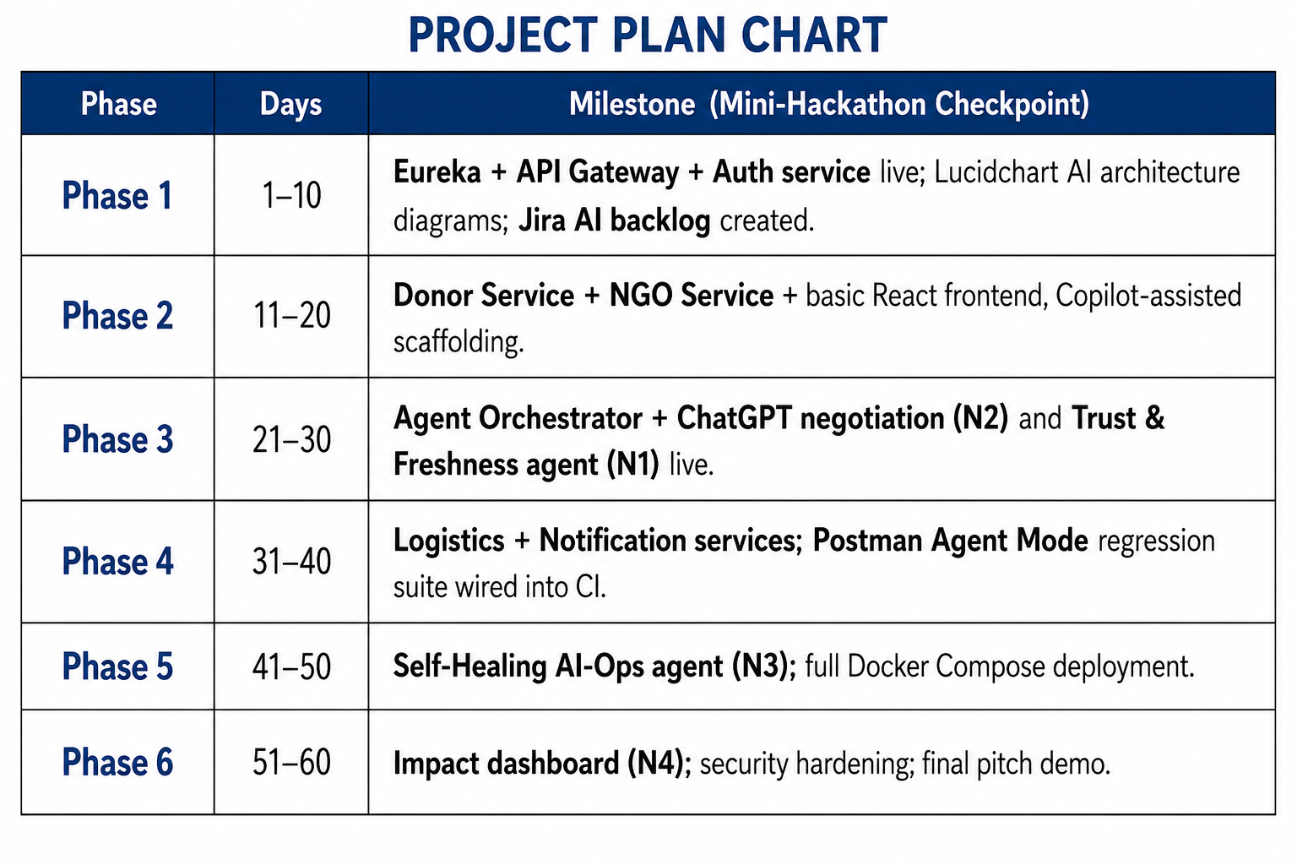
Feasibility and Project Plan
The required technologies such as React, Spring Boot, MySQL, Python/ML libraries, and Docker are freely available and support the development of the system.
The project is technically, economically, and operationally feasible, with each module developed and tested independently.

